Slide 1

IILM UNIVERSITY
STUDENT CREDENTIALS
GREATER NOIDA, UTTAR PRADESH
Priyam Bhowmik
Enrollment / Roll No.
Program & Semester
2410031539
B.Tech (CSE)
YUVAINTERN – JUNIOR WEB DEVELOPER INTERNSHIP
Online Property Tax Payment Portal
Design & Development for E-Governance & Digital Services – An Internship Presentation Report
INTERNSHIP DURATION
HOST ORGANIZATION
29 July 2026 – 26 August 2026 (4 Weeks)
YuvaIntern
Supported by the NSDC Skill Initiative

Slide 2


Candidate & Program Overview
Candidate Details
Internship Profile
Student Name: Priyam Bhowmik
Program Name: YuvaIntern – Junior Web Developer Internship
Roll Number: 2410031539
Specialization Domain: E-Governance & Digital Services
Degree: B.Tech (Computer Science & Engineering)
Duration: 4 Weeks (29 Jul – 26 Aug 2026)
Academic Batch: 2026-27
Certificate No.: YI/2026/152718/359443
University: IILM University, Greater Noida, U.P.
Location: Remote
2

Slide 3



Organization Profile: YuvaIntern
YuvaIntern is a virtual internship and skill-certification platform that provides students with hands-on, project-based internship experience across web development, data science, digital marketing, and e-governance technologies.
NSDC Partnership
Henry Harvin Group
Core Focus Domains
Operates in partnership with the National Skill Development Corporation (NSDC), aligning with national skill-development initiatives.
Functions under the Henry Harvin group of companies, with offices in the United States, India, and the UAE.
Web Development, Data Science, Digital Marketing, and E-Governance Technologies.
3

Slide 4
Problem Statement & Industry Context
The Industry Challenge
The Solution Scope
Municipal property tax collection in many Indian towns and cities continues to rely on manual, in-person, or paper-based processes for assessment, billing, and payment – creating long queues, delayed record-keeping, limited transparency, and higher administrative overheads for local bodies.
This internship addresses the design and prototyping of a secure, accessible, citizen-facing Online Property Tax Payment Portal – covering requirements analysis, responsive UI prototyping, backend & database design, and a performance, accessibility, and security audit.
“A well-designed digital portal turns a multi-day municipal visit into a two-minute online payment.”
4

Slide 5




Core Project Objectives
Requirements & Planning
Responsive UI/UX Design
Backend & Database Management
Performance & Security Audit
Analysed citizen and administrator requirements for an online property tax payment service.
Designed a responsive, accessible web prototype covering desktop, tablet, and mobile users.
Designed system architecture, database schema, secure APIs, and backup & recovery planning.
Conducted a performance, accessibility (WCAG), and security audit with improvement recommendations.
5

Slide 6




Technologies & Toolchain
Frontend
Backend & Database
Version Control & Testing
Audit & Security
HTML5, CSS3, JavaScript
Bootstrap
Figma (wireframes & mockups)
Node.js / Express.js
MySQL
RESTful API design
Git and GitHub
Postman (API testing)
Manual test-case design
Google Lighthouse
WAVE Accessibility Checker
OWASP Top 10 guidelines
6

Slide 7



System Architecture
Presentation Layer
Application / Logic Layer
Data Layer
Responsive front end (HTML5, CSS3, JavaScript, Bootstrap) delivering registration, tax lookup, payment, and receipt screens.
Server-side layer handling authentication, tax-calculation logic, payment-flow orchestration, and RESTful API endpoints.
Relational database (MySQL) with a normalized schema storing property, citizen, and transaction records.
Data flow: Citizen Browser → Presentation Layer → Application / Logic Layer → Data Layer (MySQL)
7

Slide 8
Weekly Timeline (Weeks 1 to 4)
1
2
3
4
Week 1
Week 2
Week 3
Week 4
Planning & Requirements Analysis
Responsive Web Prototype Design
Backend Integration & Database Management
Performance, Accessibility & Security Audit
Requirement report describing the proposed e-governance service and initial GitHub repository setup.
Wireframes/mockups and design-rationale report covering accessibility, responsiveness, and usability.
System architecture, database schema design, secure API design, and backup & recovery planning.
Audit report with performance KPIs, WCAG accessibility assessment, and security vulnerability analysis.
8

Slide 9

Key Deliverables & Demonstrated Skills
Requirement Analysis Report
Documented e-governance service requirements and defined the project scope for the property tax portal.
Responsive UI Prototype
Designed wireframes and mockups with accessibility, responsiveness, and usability in mind.
Backend & Database Design
Designed system architecture, a normalized database schema, secure APIs, and backup & recovery planning.
Performance & Accessibility Audit
Benchmarked the prototype against WCAG guidelines and key page-performance metrics.
Security Assessment
Evaluated the platform against the OWASP Top 10 web-application security risks.
9

Slide 10
Certification & Official Verification
Verification Metric | Official Record / Credential Details
Internship Title | Junior Web Developer – E-Governance & Digital Services
Issuing Organization | YuvaIntern (in partnership with NSDC)
Certificate No. | YI/2026/152718/359443
Date of Issue | August 26, 2026
Internship Duration | 29 July 2026 – 26 August 2026 (4 Weeks, Remote)
Founder / Signatory | Kounal Gupta, Founder, YuvaIntern
10

Slide 11
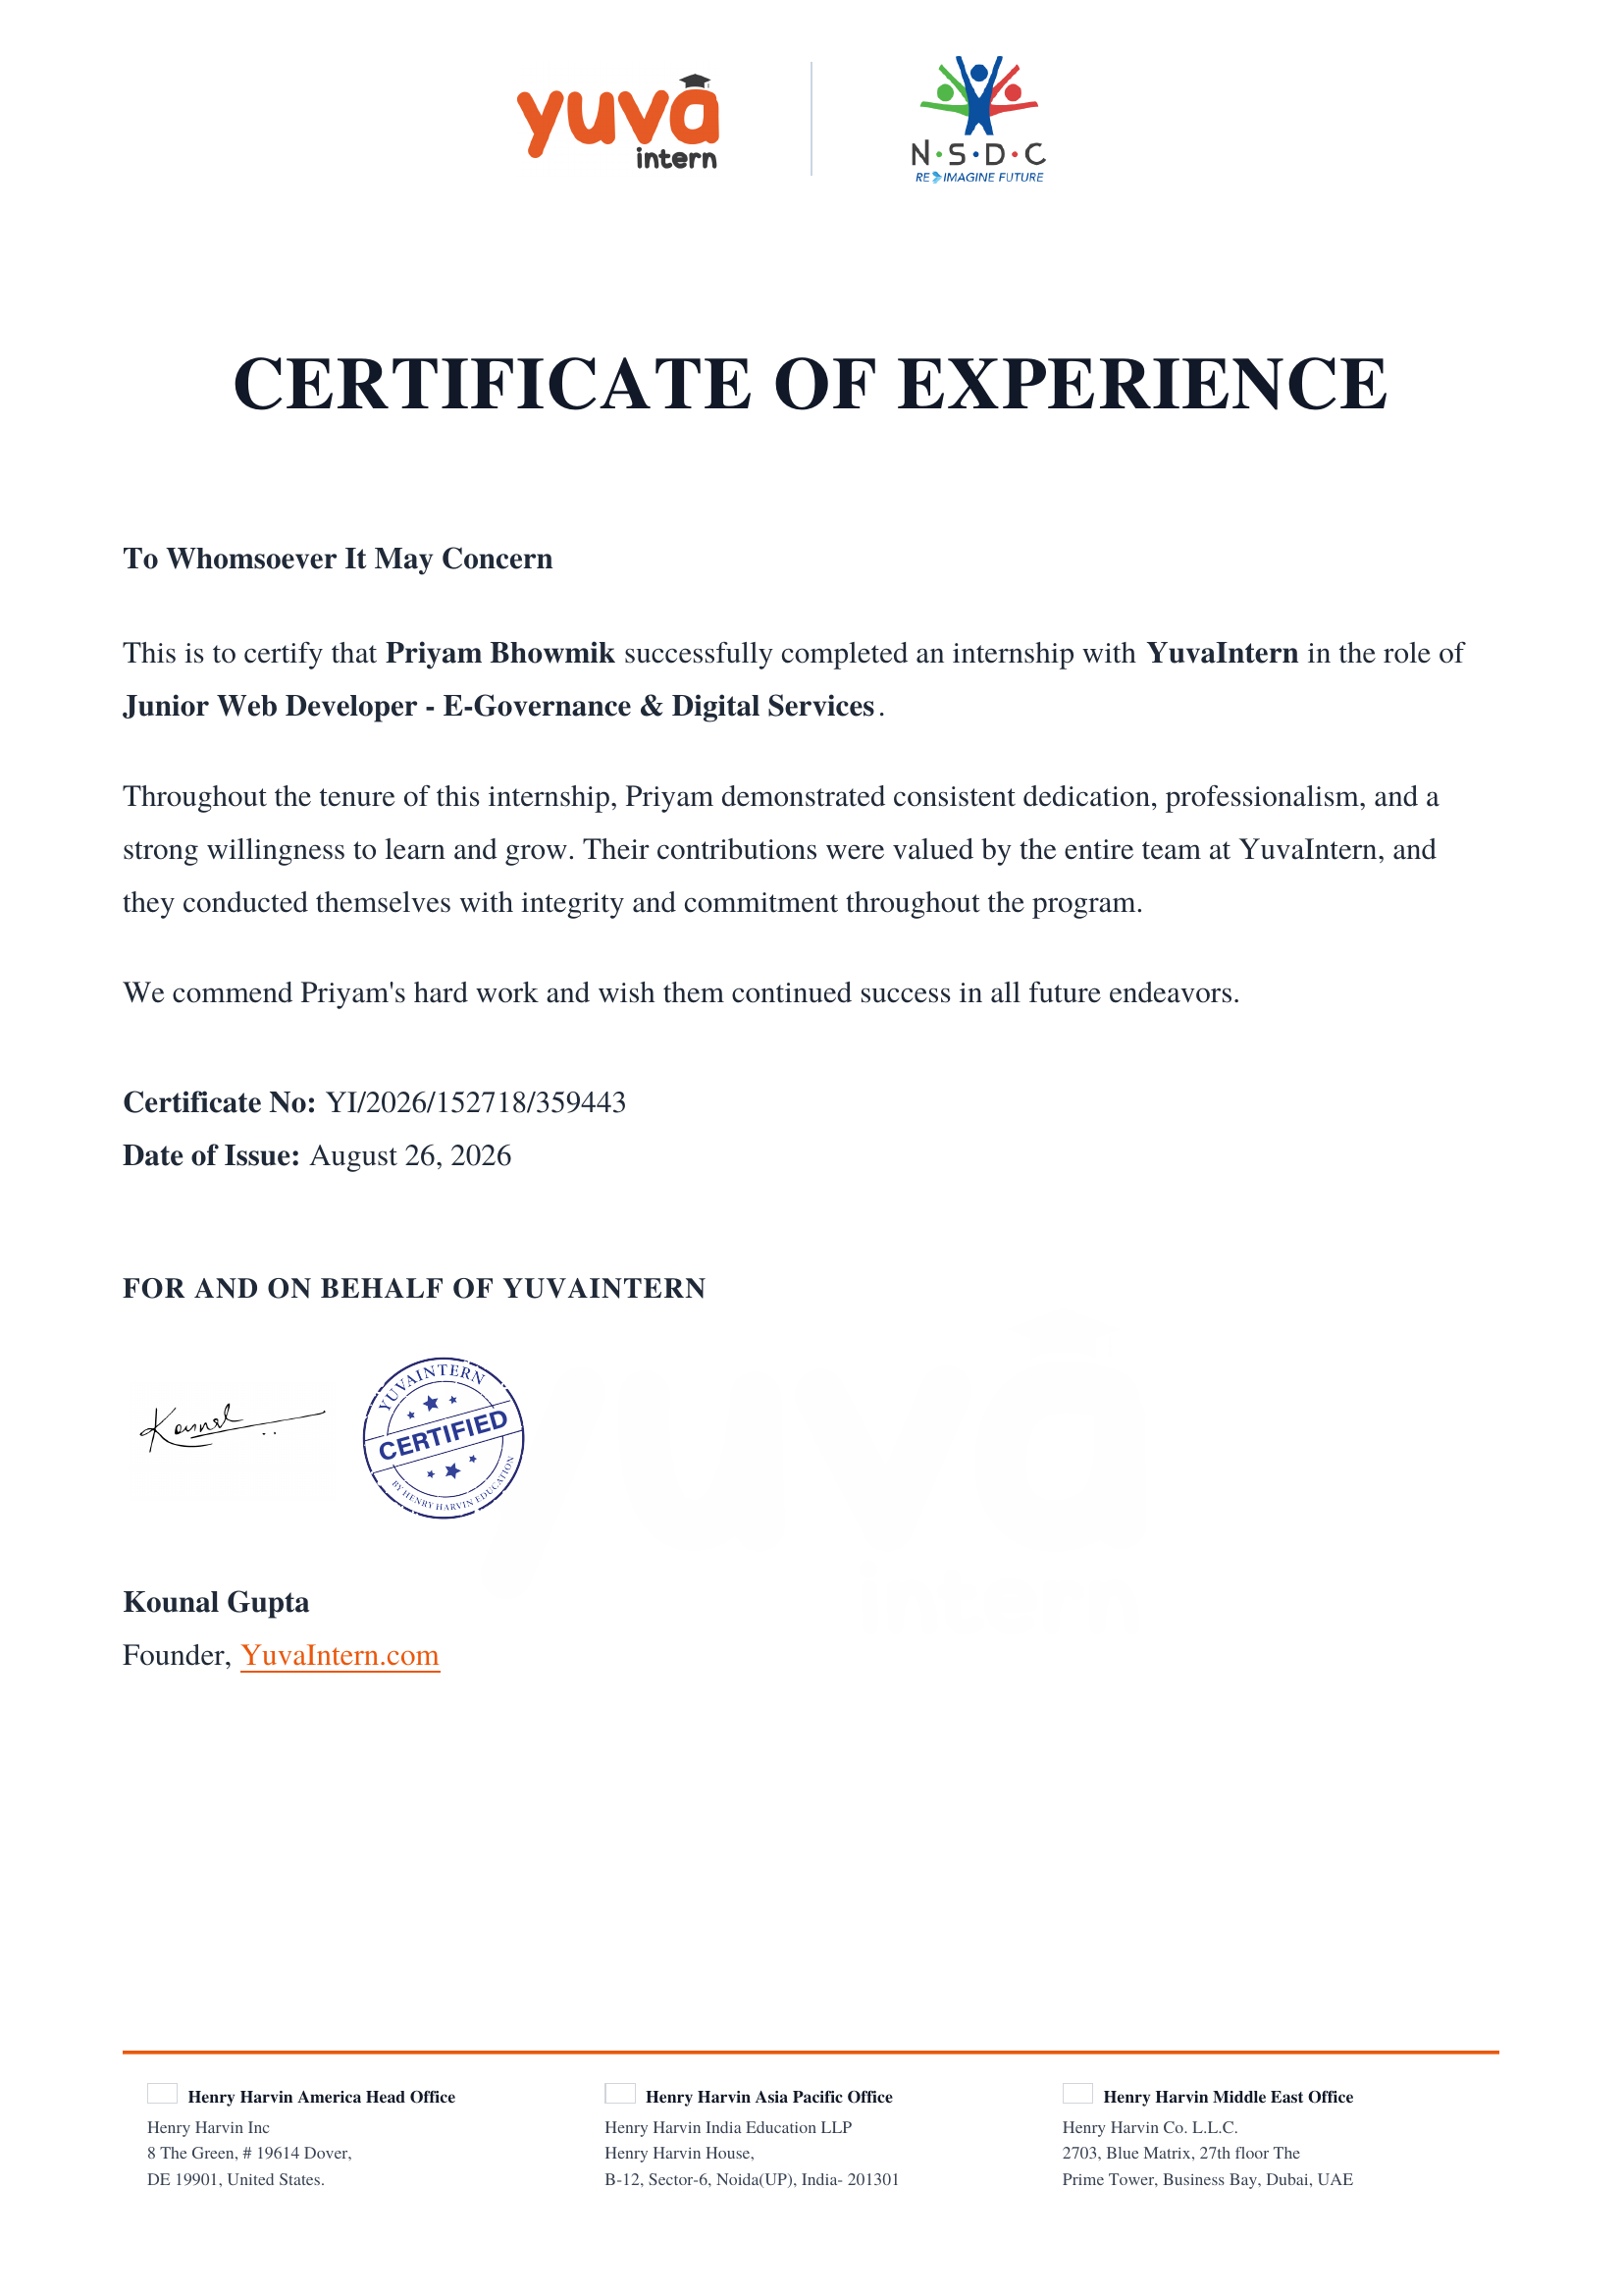
Certificate of Experience
11

Slide 12
Thank You!
Priyam Bhowmik
School of Computer Science & Engineering
Roll No: 2410031539
IILM University, Greater Noida, U.P.

